Slide 1
CONSTRAINTS AND TRIGGERS

Slide 2
Objectives
Understand concepts of
Keys and foreign keys
Constraints on attributes and tuples
Modification of constraints
Assertions
Triggers

Slide 3
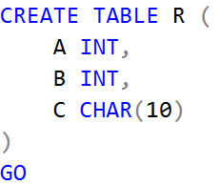

Creating, Dropping SQL Tables
Suppose relation R(A int, B int, C char(10))
SQL script to create or drop relation R
Drop both schema and instance of relation

Slide 4
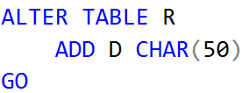
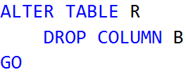
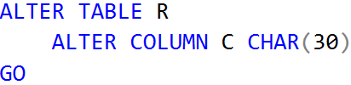
Altering SQL Tables
A relation R(A int, B int, C char(10)) has been created and we need
Expand it by adding new attribute D char(50)
Remove existing attribute (B)
Alter attribute C to char (30)

Slide 5
Keys and Foreign Keys
There are some kinds of keys in SQL
PRIMARY KEY
UNIQUE KEY
FOREIGN KEY

Slide 6
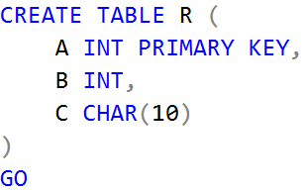
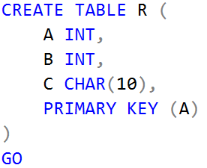
Declaring Primary Key
Suppose relation R(A int, B int, C char(10)) with primary key {A}
SQL script to create relation R

Slide 7
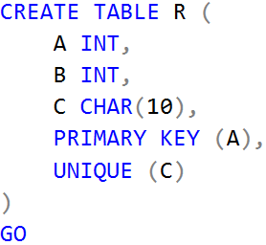
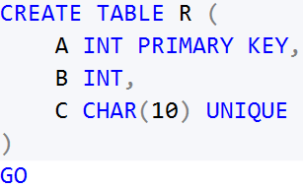
Declaring Primary Key
Suppose relation R(A int, B int, C char(10)) with primary key {A}, unique key {C}
SQL script to create relation R

Slide 8
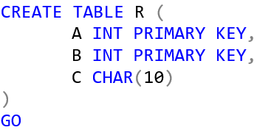
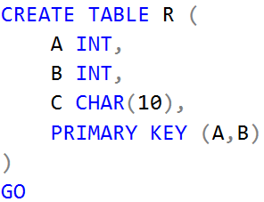
Declaring Primary Key
Suppose relation R(A int, B int, C char(10)) with primary key {A,B}

Slide 9
Declaring Foreign Key Constraints
Recall to referential integrity constraints
Other name is foreign key constraints
A value appearing in component(s) of one relation must also appear in the primary key component(s) of another relation
That component(s) is (are) called foreign key
We can say, some attribute(s) of one relation refer some attribute(s) of a second relation
Referenced attribute(s) must be primary key
Referencing attribute(s) are called foreign key

Slide 10
Declaring Foreign Key Constraints
The referenced attribute(s) of the second relation must be declared UNIQUE or the PRIMARY KEY
Values of the foreign key appearing in the first relation must also appear in the referenced attributes of some tuple

Slide 11
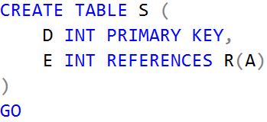
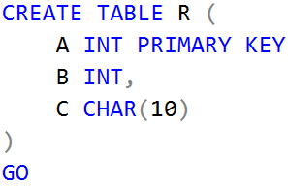
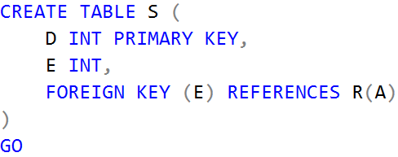
Declaring Primary Key
Suppose
Relation R(A int, B int, C char(10))
Relation S(D int, E int), where E is refered to A of R
Q: Which relation must be
created first? R or S? Why?

Slide 12
Maintaining Referential Integrity
Suppose
Relation R(A int, B int, C char(10))
Relation S(D int, E int), where E is refered to A of R
Some actions might violate the above constraint
Insert a new tuple to S (why?)
Update a tuple in S to change the value of E (why?)
Update a tuple on R to change the A component (why?)
Delete a tuple from R (why?)

Slide 13
Maintaining Referential Integrity
Suppose
Relation R(A int, B int, C char(10))
Relation S(D int, E int), where E is refered to A of R
Scope of referential integrity
 | INSERT | UPDATE | DELETE
R | NO | YES | YES
S | YES | YES | NO

Slide 14
Maintaining Referential Integrity
Three options to solve constraint’s violation
The default policy: SQL reject all constraint’s violations
The cascade policy: Changes to the referenced attribute(s) are mimicked at the foreign key
The Set-Null policy: Changes to the referenced attribute(s) set a foreign key value to NULL

Slide 15
Constraints on Attributes and Tuples
Within a SQL CREATE TABLE statement, we can declare two kinds of constraints
A constraint on a single attribute
Attribute-Based CHECK Constraints
A constraint on a tuple as a whole
Tuple-Based CHECK Constraints

Slide 16
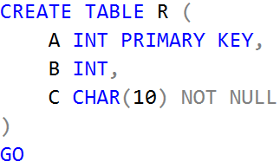
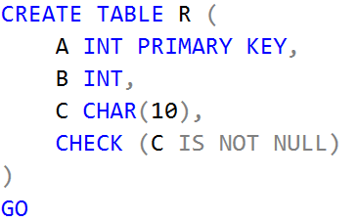
Not-Null Constraints
Suppose
Relation R(A int, B int, C char(10)), where C is not null
Importance:
- We can’t insert new tuple with null at C
- We can’t change value of C to null

Slide 17
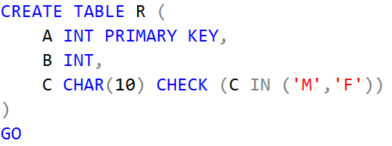
Attribute-Based CHECK Constraints
Suppose
Relation R(A int, B int, C char(10)), where C must be ‘M’ or ‘F’ only
Importance:
We just insert new tuple with ‘M’ or ‘F’ at C,
or we just change value of C to ‘M’ or ‘F’,
otherwise, we get error

Slide 18
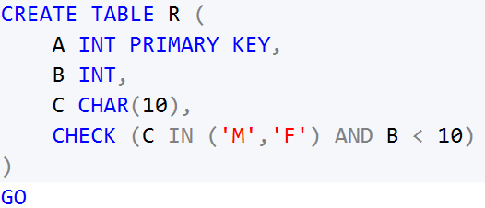
Tuple-Based Check Constraints
Suppose
Relation R(A int, B int, C char(10)), where C must be ‘M’ or ‘F’ only and B is less than 10

Slide 19
SUMMARY
There are some kinds of constraints
Primary key constraint
Unique key constraint
Foreign key constraint
Attribute-based constraint
Tuple-based constraint
We define them in CREATE table statement
What happens if we just detect them after table CREATION? WE NEED TO MODIFY TABLE!

Slide 20
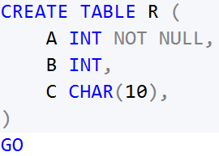
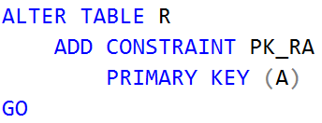
Modifying Tables to Declare Constraints
Suppose relation R(A int, B int, C char(10)) with primary key {A}
This A must be in NOT NULL to
become a PRIMARY KEY

Slide 21
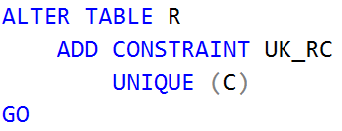
Modifying Tables to Declare Constraints
Suppose relation R(A int, B int, C char(10)) with primary key {A}, unique key {C}

Slide 22
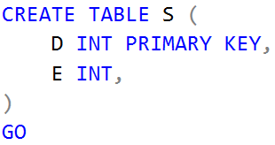
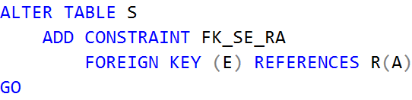
Modifying Tables to Declare Constraints
Suppose
Relation R(A int, B int, C char(10))
Relation S(D int, E int), where E is refered to A of R

Slide 23
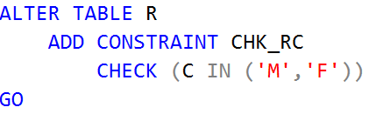
Modifying Tables to Declare Constraints
Suppose
Relation R(A int, B int, C char(10)), where C must be ‘M’ or ‘F’ only

Slide 24

Clearing Constraints From Table
How do we remove this constraint from R table?
All we need is its name!

Slide 25
SUMMARY
We define constraints in CREATE table statement
We also define them after creation of tables, too
But, all of them are just on one attribute or on tuple only.
What happens if our constraints are related to many tuples in a table or in many tables? Let’s start with TRIGGER!!!

Slide 26
Triggers
Trigger is a user-defined object, which runs permanently as a back-end process
Triggers differ from the other constraints
Triggers are only awakened when certain events occur
One awakened, the trigger tests a condition.
If the condition does not hold, trigger do nothing to response to occurred event
If the condition is satisfied, the action associated with trigger is performed by the DBMS
Let’s see some examples

Slide 27
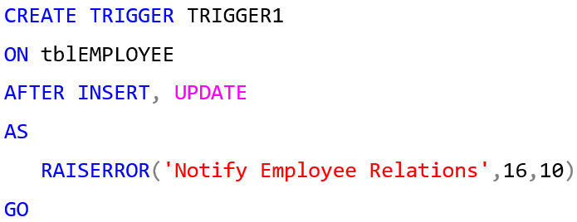
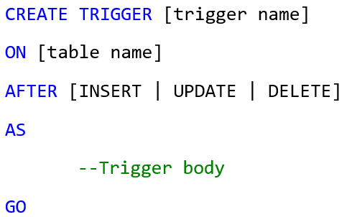
Creating SQL Triggers
Create the trigger TRIGGER1 raised error message after insert or update on tblEmployee table
TRIGGER1
tblEmployee
INSERT, UPDATE
RAISERROR('Notify Employee Relations',16,10)

Slide 28
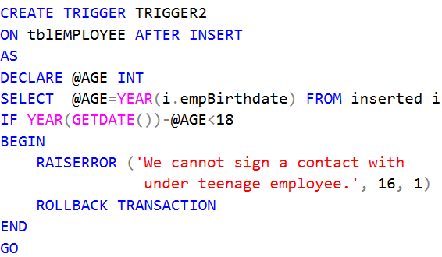
Creating SQL Triggers
Create the trigger that refuses all under-18-year-old employee’s insertion
inserted is a clone of new tuple, which has just been added to employee table

Slide 29
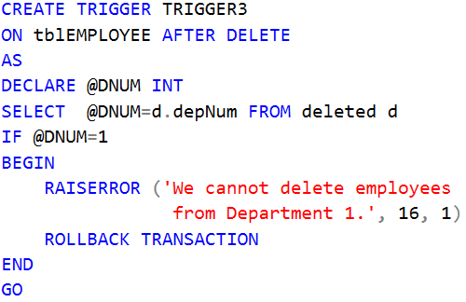
Creating SQL Triggers
Create the trigger that refuses deleting employees from Department 1
deleted is a clone of old tuple, which has just been deleted from employee table

Slide 30
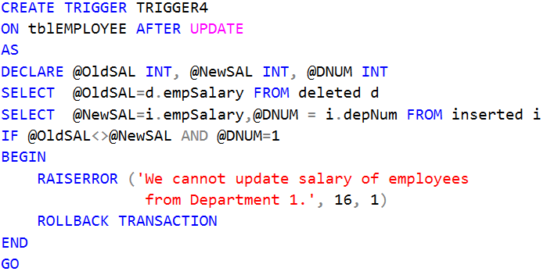
Creating SQL Triggers
Create the trigger that refuses updating salary of employees from Department 1
Both inserted and deleted must be used to get old and new salary of updating employee

